Slide 1
Credit Card Default Prediction
DTSA 5510: Unsupervised Algorithms in Machine Learning

Slide 2
Agenda
Introduction - Problem Statement
Overview of Dataset & EDA
Data Distribution, Outliers, and Missing Data
Model Setup
Results!
Conclusion - Lessons Learned

Slide 3
Problem Statement
Credit card default prediction is significant for financial institutions because it impacts their profitability and risk management strategies. Accurate prediction helps these institutions take proactive measures to mitigate potential losses.
The primary aim of this project is to assess the efficacy of unsupervised learning techniques in predicting credit card defaults and compare their performance with traditional supervised learning methods.

Slide 4
Dataset Overview
Dataset Overview:
Title: "Default of Credit Card Clients" by Markelle Kelly, Rachel Longjohn, Kolby Nottingham hosted on UCI.
Size: 30000 client records and 23 distinct features.
Data Composition:
Includes financial, client payment history, and demographic data of clients
Features range from continuous numeric (credit card limit, payment history, bill amounts) to categorical (e.g., age, gender, education).
Critical Variables:
Outcome variable: “Default” (0 or 1 indicating default status).
Notes:
APACHE codes are part of the APACHE (Acute Physiology And Chronic Health Evaluation) scoring system, a classification system that is widely used in intensive care medicine to assess the severity of illness and predict outcomes in critically ill patients. Here’s a bit more about the system and its components:

Slide 5
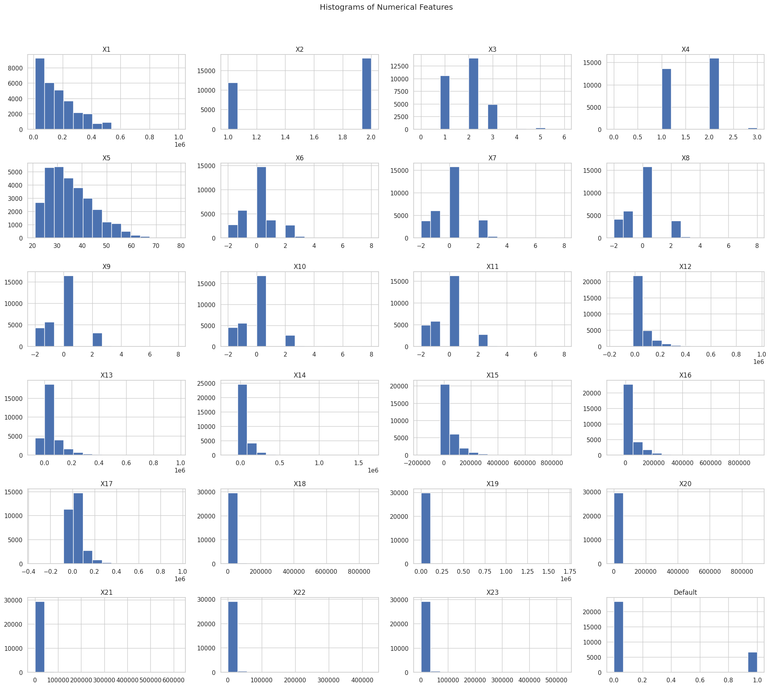
Data Distributions
The majority of the features (X1, X12-X23) exhibit right-skewed distributions, with most values concentrated towards the lower end of the range, indicating a common pattern in the data.
Several features (X2, X4, X6-X11) show multimodal distributions, suggesting the presence of multiple subgroups or clusters within the data.
The target variable, "Default," is binary and displays class imbalance, with more non-defaulters (0s) than defaulters (1s).

Slide 6
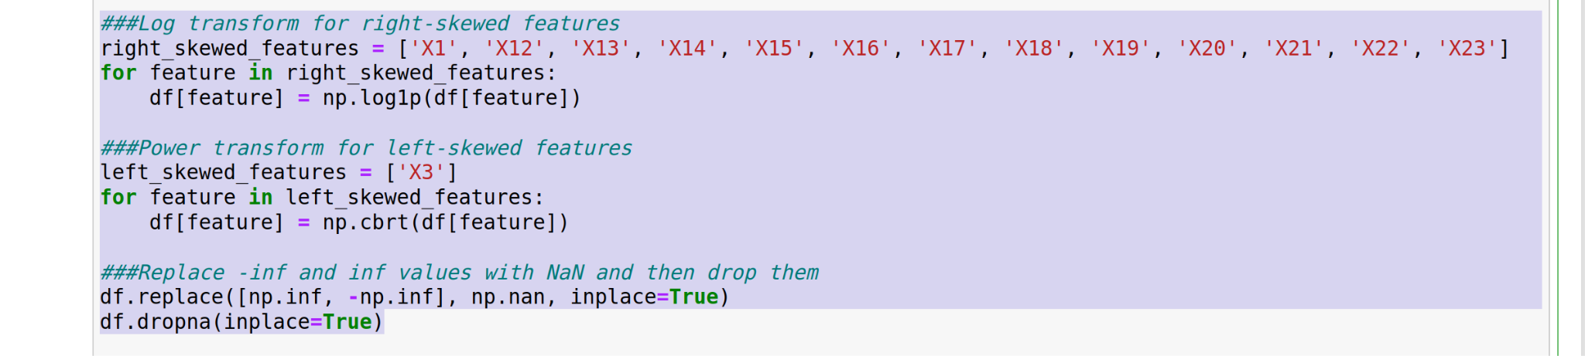
Missing Data
No missing data noted in this data set.
However, after data distribution modifications (de-skewing features), there were rows that had to be dropped due to np.inf and -np.inf values.
Resulting in ~2000 rows being dropped.

Slide 7
Outliers
Outlier Detection Strategy:
Utilized z-score analysis with a threshold of 3 to identify outlier data points defining outliers as those significantly deviating from the mean in terms of standard deviation units.
Flexibility and Adjustment:
The method allows for adjustments in the sensitivity of outlier detection providing a robust tool for preprocessing and ensuring data quality by addressing extreme variations.
Impact on Dataset:
This approach led to the removal of a few hundred observations categorized as outliers refining the dataset for more representative and unbiased statistical analysis.

Slide 8
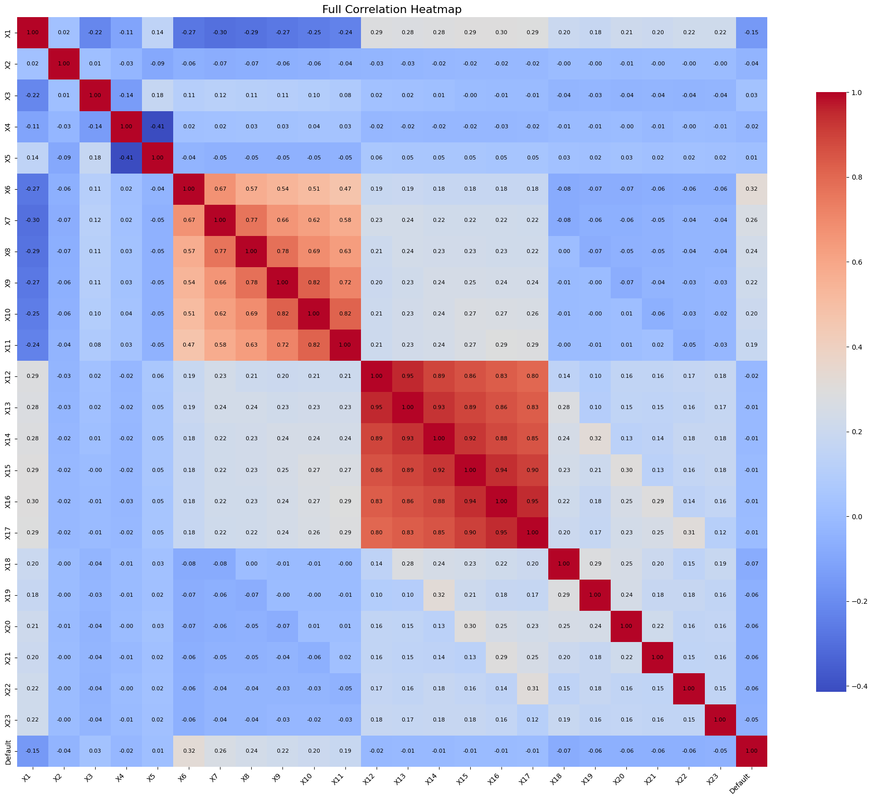
Data Correlation Matrix
Significant Correlations and Redundancies:
Detected strong correlations (>0.9) among variables indicating dependencies that could impact model performance due to multicollinearity and overfitting.
Implications for Modeling and Data Reduction:
High correlations among similar measurements and predictive metrics like suggest redundancy; removing one from each correlated pair can streamline models and enhance efficiency without losing essential information.
Data Reduction
5 features dropped due to correlations >0.9

Slide 9
Model Training
Preparation and Preprocessing:
After preprocessing to standardize numerical features and one-hot encode categorical variables, dimensionality was reduced using PCA to focus on the most informative features enhancing model training efficiency.
Model Training and Optimization:
Trained a variety of models including logistic regression, random forest, XGBoost, optimizing hyperparameters via GridSearchCV to evaluate model effectiveness based on cross-validation accuracy.
For Unsupervised learning, the approach tested BIRCH, KMeans, and Agglomerative clustering techniques. Silhouette score was used to determine best model on validation set. Accuracy was determined applying majority class of a cluster to a test observation.
Experimental Approaches:
Conducted experiments where we performed data transformation, and then data transformation with SMOTE to handle class imbalance to compare impacts on model performance and generalizability.

Slide 10
Experiment Results - Unsupervised Learning w/ Data Transformations
Model | Configuration | Accuracy | Precision | Recall
KMeans | Combined | 0.789853 | 0.394927 | 0.5
 | Train | 0.789853 | 0.394927 | 0.5
Agglomerative | Combined | 0.789853 | 0.394927 | 0.5
 | Train | 0.789853 | 0.394927 | 0.5
BIRCH | Combined | 0.789853 | 0.394927 | 0.5
 | Train | 0.789853 | 0.394927 | 0.5

Slide 11
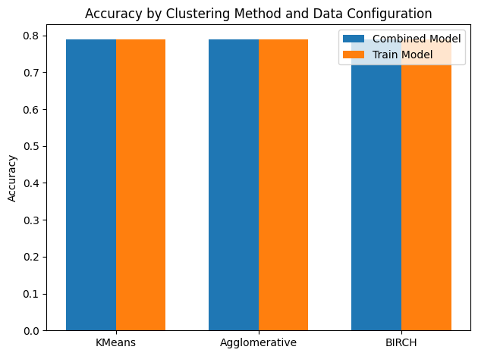
Experiment Results - Unsupervised Learning w/ Data Transformations

Slide 12
Experiment Results - Supervised Learning w/ Data Transformations
Model | Accuracy | Precision | Recall
XGBoost | 0.8315086782376502 | 0.68 | 0.38
Random Forest | 0.8317757009345794 | 0.68 | 0.38
Logistic Regression | 0.822429906542056 | 0.64 | 0.33

Slide 13
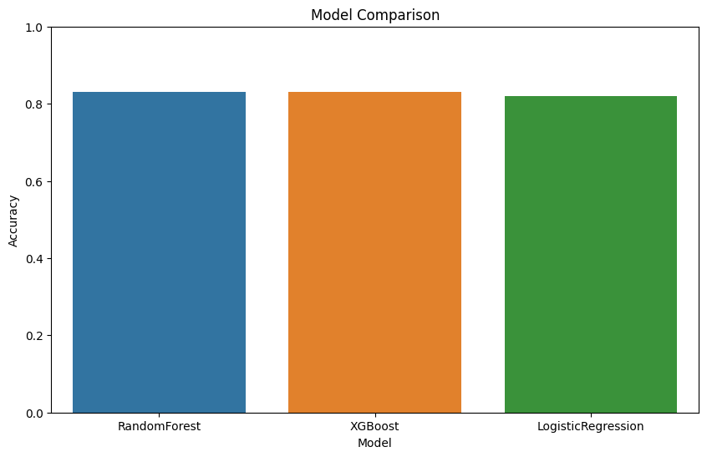
Experiment Results - Supervised Learning w/ Data Transformations
Notes:
'''
Data Transformation w/ SMOTE Best parameters found for RandomForest: {'max_depth': None, 'min_samples_leaf': 1, 'min_samples_split': 2, 'n_estimators': 200}
RandomForest Accuracy on test data: 0.8494971876597921
Data Transformation: Best parameters found for RandomForest: {'max_depth': 10, 'min_samples_leaf': 4, 'min_samples_split': 2, 'n_estimators': 200}
RandomForest Accuracy on test data: 0.8317757009345794
Best parameters found for RandomForest: {'max_depth': 10, 'min_samples_leaf': 1, 'min_samples_split': 10, 'n_estimators': 200}
RandomForest Accuracy on test data: 0.8084242578025882
'''
'''
Data Transformation with SMOTE Best parameters found for XGBoost: {'learning_rate': 0.1, 'max_depth': 15, 'n_estimators': 200, 'subsample': 0.8}
XGBoost Accuracy on test data: 0.8569967615476394
Data Transformation Best parameters found for XGBoost: {'learning_rate': 0.1, 'max_depth': 3, 'n_estimators': 50, 'subsample': 1.0}
XGBoost Accuracy on test data: 0.8315086782376502
Best parameters found for XGBoost: {'learning_rate': 0.01, 'max_depth': 6, 'n_estimators': 200, 'subsample': 0.7}
XGBoost Accuracy on test data: 0.8051256026389241
'''
'''
Data Transformation with SMOTE Best parameters found for Logistic Regression: {'C': 0.01, 'max_iter': 100, 'penalty': 'l2', 'solver': 'sag'}
Logistic Regression Accuracy on test data: 0.704789500596557
Data Transformation Best parameters found for Logistic Regression: {'C': 0.01, 'max_iter': 100, 'penalty': 'l2', 'solver': 'newton-cg'}
Logistic Regression Accuracy on test data: 0.822429906542056
Best parameters found for Logistic Regression: {'C': 0.1, 'max_iter': 100, 'penalty': 'l2', 'solver': 'newton-cg'}
Logistic Regression Accuracy on test data: 0.7997970058360823
'''

Slide 14
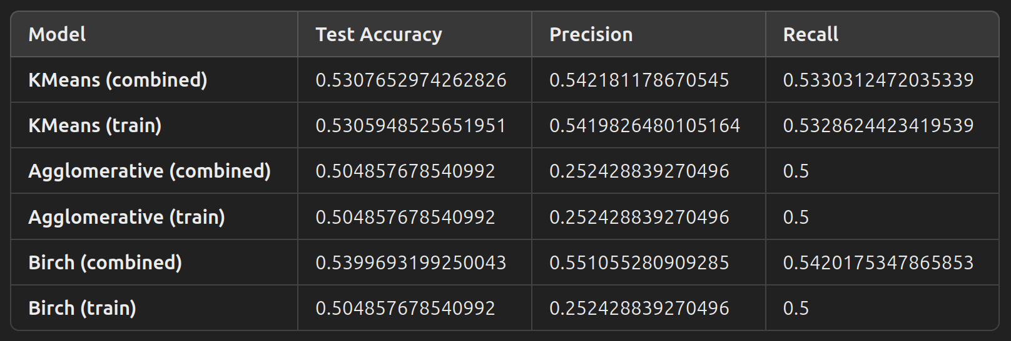
Experiment Results - Unsupervised Learning w/ Data Transformations + SMOTE

Slide 15
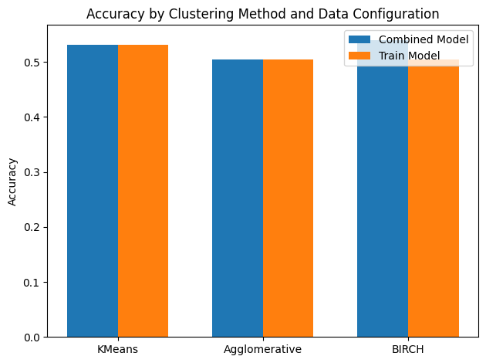
Experiment Results - Unsupervised Learning w/ Data Transformations + SMOTE
Notes:
KMeans(n_clusters=2, n_init=10) k-means++ 10
KMeans(n_clusters=2, n_init=20) k-means++ 20
KMeans(init='random', n_clusters=2, n_init=10) random 10
KMeans(init='random', n_clusters=2, n_init=20) random 20
KMeans(n_clusters=2, n_init=10) k-means++ 10
KMeans(n_clusters=2, n_init=20) k-means++ 20
KMeans(init='random', n_clusters=2, n_init=10) random 10
KMeans(init='random', n_clusters=2, n_init=20) random 20
Accuracy on test data for KMeans (combined model): 0.5307652974262826
Precision on test data for KMeans (combined model): 0.542181178670545
Recall on test data for KMeans (combined model): 0.5330312472035339
Accuracy on test data for KMeans (train model): 0.5305948525651951
Precision on test data for KMeans (train model): 0.5419826480105164
Recall on test data for KMeans (train model): 0.5328624423419539
AgglomerativeClustering() 2 ward
AgglomerativeClustering(linkage='complete') 2 complete
AgglomerativeClustering(linkage='average') 2 average
AgglomerativeClustering(linkage='single') 2 single
AgglomerativeClustering() 2 ward
AgglomerativeClustering(linkage='complete') 2 complete
AgglomerativeClustering(linkage='average') 2 average
AgglomerativeClustering(linkage='single') 2 single
Accuracy on test data for Agglomerative (combined model): 0.504857678540992
Precision on test data for Agglomerative (combined model): 0.252428839270496
Recall on test data for Agglomerative (combined model): 0.5
Accuracy on test data for Agglomerative (train model): 0.504857678540992
Precision on test data for Agglomerative (train model): 0.252428839270496
Recall on test data for Agglomerative (train model): 0.5
Birch(n_clusters=2, threshold=0.1) 2 0.1
Birch(n_clusters=2, threshold=0.3) 2 0.3
Birch(n_clusters=2) 2 0.5
Birch(n_clusters=2, threshold=0.7) 2 0.7
Birch(n_clusters=2, threshold=1.0) 2 1.0
Birch(n_clusters=2, threshold=0.1) 2 0.1
Birch(n_clusters=2, threshold=0.3) 2 0.3
Birch(n_clusters=2) 2 0.5
Birch(n_clusters=2, threshold=0.7) 2 0.7
Birch(n_clusters=2, threshold=1.0) 2 1.0
Accuracy on test data for BIRCH (combined model): 0.5399693199250043
Precision on test data for BIRCH (combined model): 0.551055280909285
Recall on test data for BIRCH (combined model): 0.5420175347865853
Accuracy on test data for BIRCH (train model): 0.504857678540992
Precision on test data for BIRCH (train model): 0.252428839270496
Recall on test data for BIRCH (train model): 0.5

Slide 16
Experiment Results - Supervised Learning w/ Data Transformations + SMOTE
Model | Accuracy | Precision | Recall
XGBoost | 0.85969967615476 | 0.85 | 0.87
Random Forest | 0.84949718765979 | 0.85 | 0.85
Logistic Regression | 0.70478950059655 | 0.74 | 0.62
Notes:
Data Transformation w/ SMOTE Best parameters found for RandomForest: {'max_depth': None, 'min_samples_leaf': 1, 'min_samples_split': 2, 'n_estimators': 200}
RandomForest Accuracy on test data: 0.8494971876597921
'''
Data Transformation with SMOTE Best parameters found for XGBoost: {'learning_rate': 0.1, 'max_depth': 15, 'n_estimators': 200, 'subsample': 0.8}
XGBoost Accuracy on test data: 0.8569967615476394
'''
'''
Data Transformation with SMOTE Best parameters found for Logistic Regression: {'C': 0.01, 'max_iter': 100, 'penalty': 'l2', 'solver': 'sag'}
Logistic Regression Accuracy on test data: 0.704789500596557

Slide 17
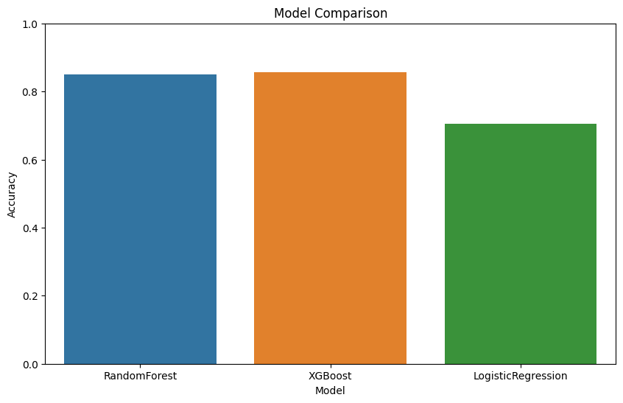
Experiment Results - Supervised Learning w/ Data Transformations + SMOTE

Slide 18
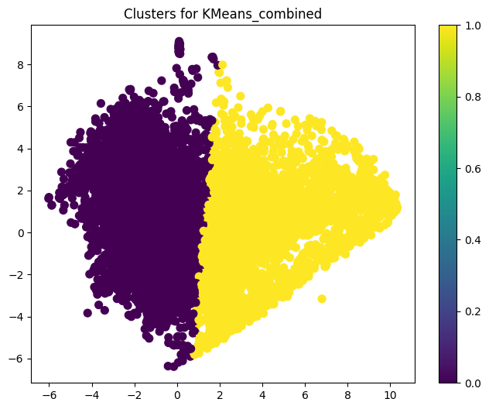
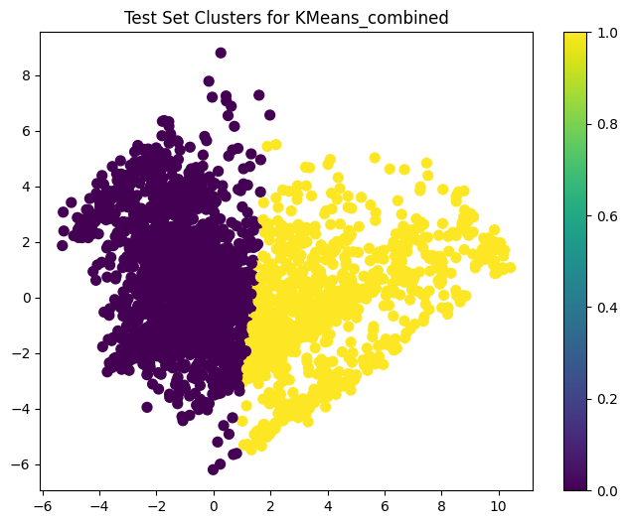
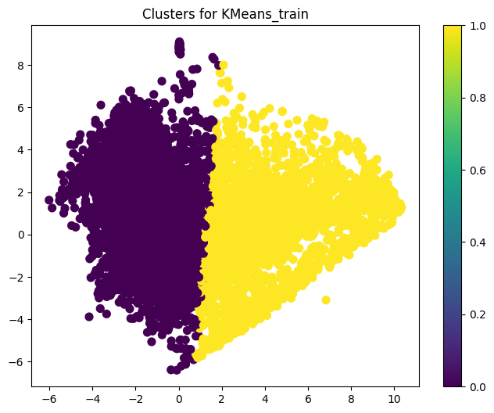

Cluster Visualizations

Slide 19
Conclusion - Lessons Learned
Conclusion of Experiments:
Despite employing strategies like GridSearch, dimensionality reduction, and SMOTE for class imbalance, the unsupervised models did not reach the performance standards necessary for production in a financial setting. However, supervised learning clearly excelled.
Lessons Learned:
The data doesn’t contain enough structure to inform Unsupervised Techniques. Labels are very much needed.
Good clusters != Predictive performance
Next Steps for Improvement:
Explore additional Dimensionality reduction techniques
Better data collection - more observations might improve modeling effort.

Slide 20
Thank you!

